Slide 1
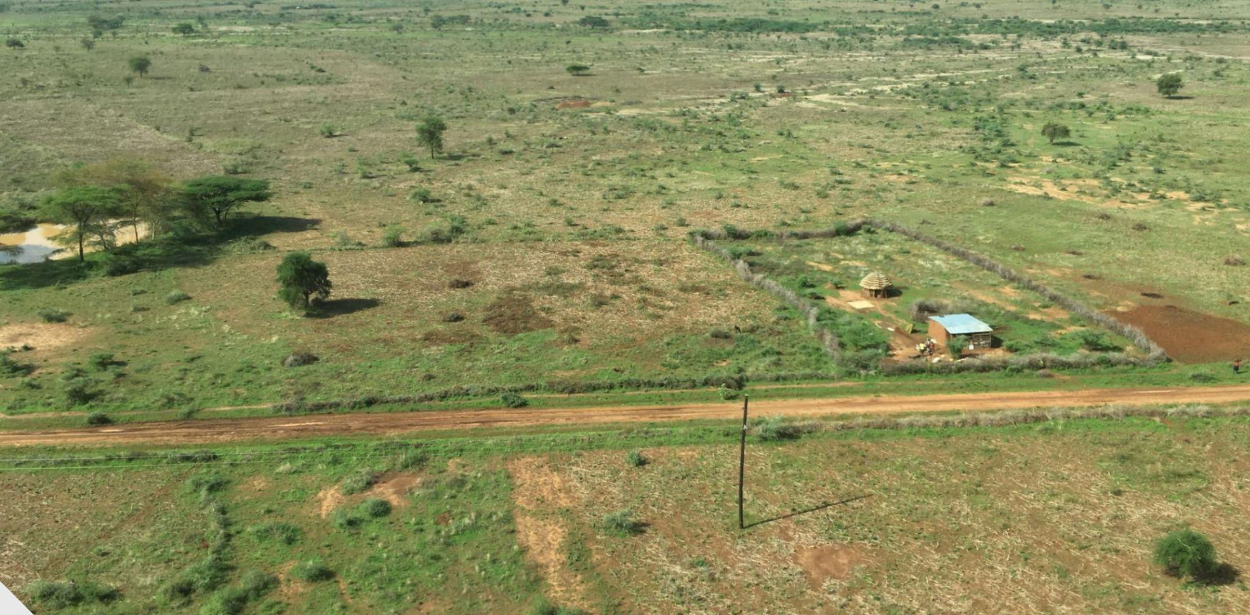
Pastoral Systems and Reductions in Aid: Fallout from international Aid Cuts, Challenges and Prospects
Moffatt K. Ngugi (PhD)
Personal reflections from a Development Professional : Exploring the implications of aid cuts and sustainable alternatives

Slide 2
Introduction
Overview of the contemporary humanitarian and development aid model.
Importance of aid for pastoral and agro-pastoral communities.
Recent global trends: USAID, UK, and EU aid cuts.
Notes:
The arid and semi-arid lands (ASAL) along the borders between Kenya and its neighbors have been afflicted for many years by conflict among pastoralists and agropastoralists from diverse ethnicities and clans. Recurrent drought, authoritarian governance, political marginalization, resource scarcity and, in some places, violent extremism, have combined to destabilize communities and impede economic development. PEACE III is a US$20 million United States Agency for International Development (USAID) cooperative agreement that responds to these challenges by strengthening the management of conflict along the Kenya/Somalia, Kenya/Ethiopia, Kenya/South Sudan and Kenya/Uganda borders. Implemented by Pact in partnership with Mercy Corps from 2014 through 2019, PEACE III promotes stability in the region by strengthening the relationship between communities and local governments in cross-border areas and improving the ability of regional and national institutions to respond rapidly and effectively to conflict.

Slide 3
The Aid Model
Contributions:
Provided emergency relief, education, healthcare, and climate adaptation.
Supported governance, policy reforms, and capacity building.
Created employment opportunities and market linkages.
Drawbacks:
Risk of long-term dependency.
Inefficiencies and misallocation of resources.
Political influence shaping aid distribution.

Slide 4
Case Studies – The Impact of Aid Cuts
USAID Cuts: Shutdown of key pastoral livelihood projects, governance reforms.
UK & EU Reductions: Impact on climate adaptation and resilience programs.
Notes:
https://usaid.maps.arcgis.com/apps/Cascade/index.html?appid=d201dc53eb9f401c910be1f217c10b05

Slide 5
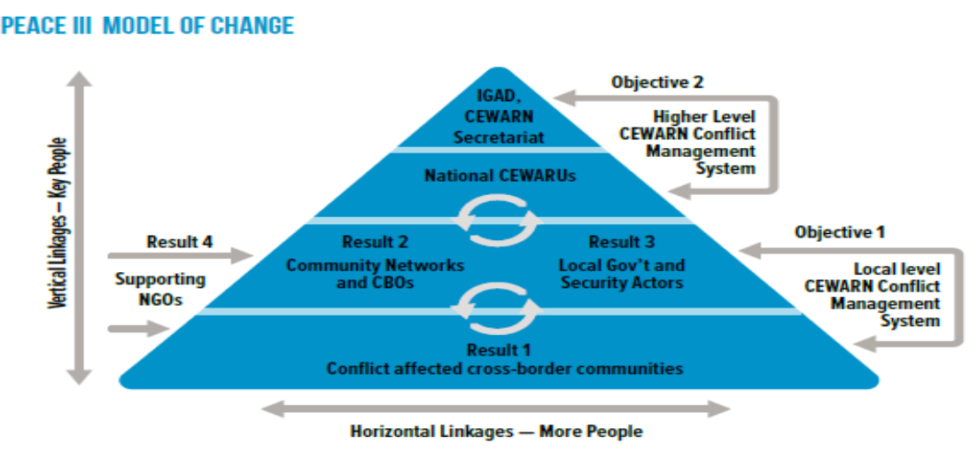
Objectives, Target Groups, and Key Institutions for PEACE III
Example PEACE III in East Africa
Strengthen local cross-border management systems
Improve responsiveness of regional/national institutions to cross-border conflict
Notes:
Essence of the project was developing relationships between institutions and key peace actors. That network of relationships contributed to conflict prevention and peace building.
IF communities and local government are aware of the links between conflict and climate change, and engage in processes that strengthen the peaceful management of communal resources THEN capacities to cope with climate change will be strengthened.
IGAD signs the MOU that gives Mercy Corps the ability to interact with the various actors.

Slide 6
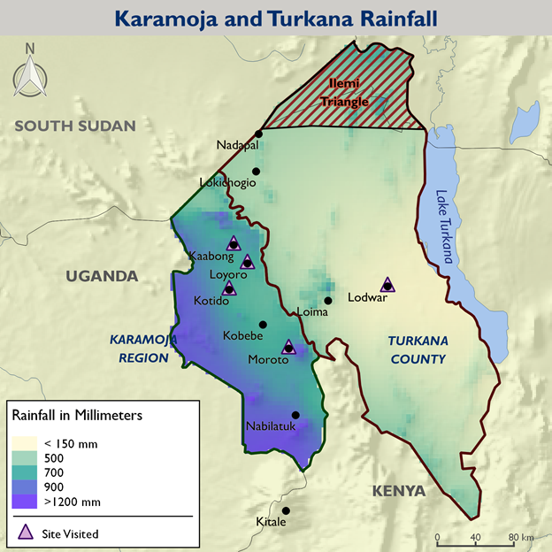

Slide 7
Why Are Donors Retreating?
USA: Shift to an "America First" approach, USAID absorption into the State Department.
UK: Redirection of funds from aid to defense.
EU: Budget reallocations due to crises (Ukraine, Gaza, Syria).

Slide 8
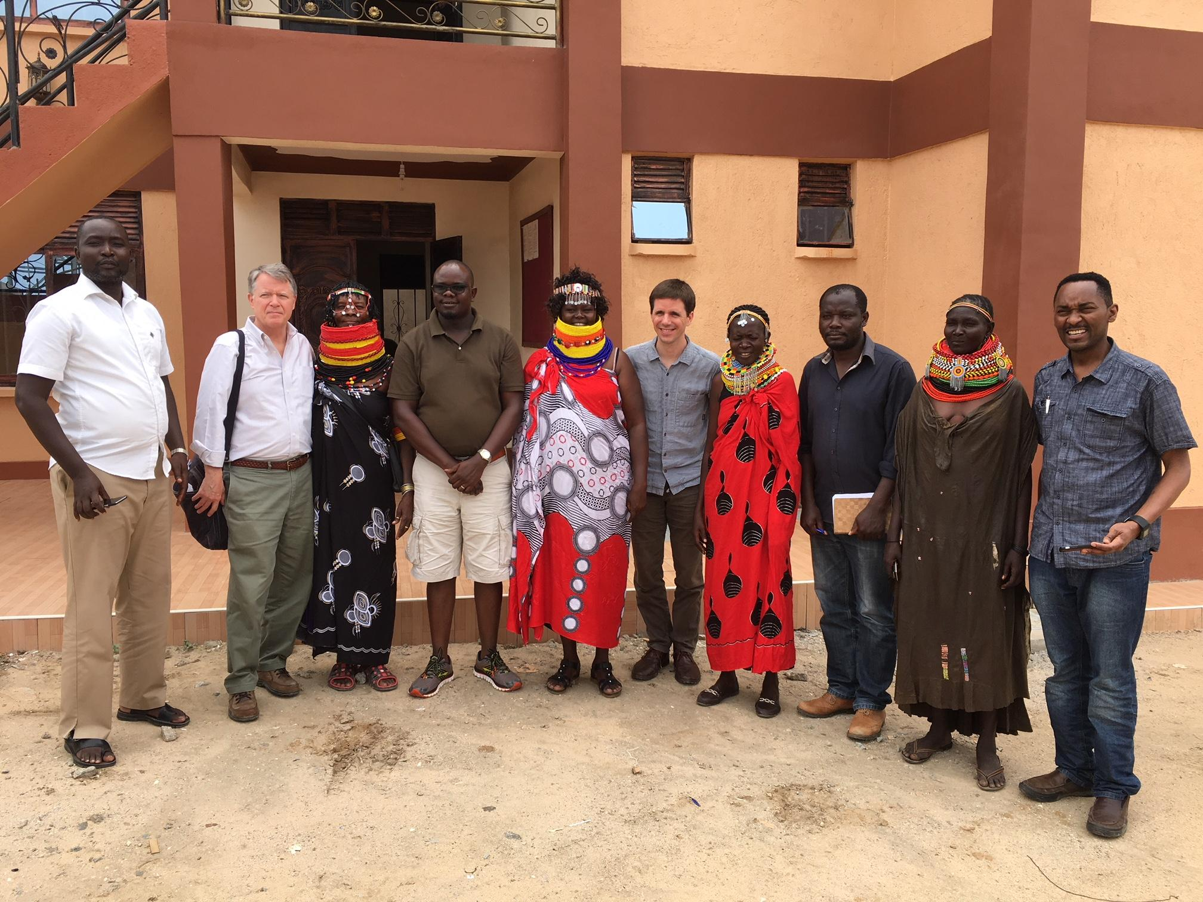
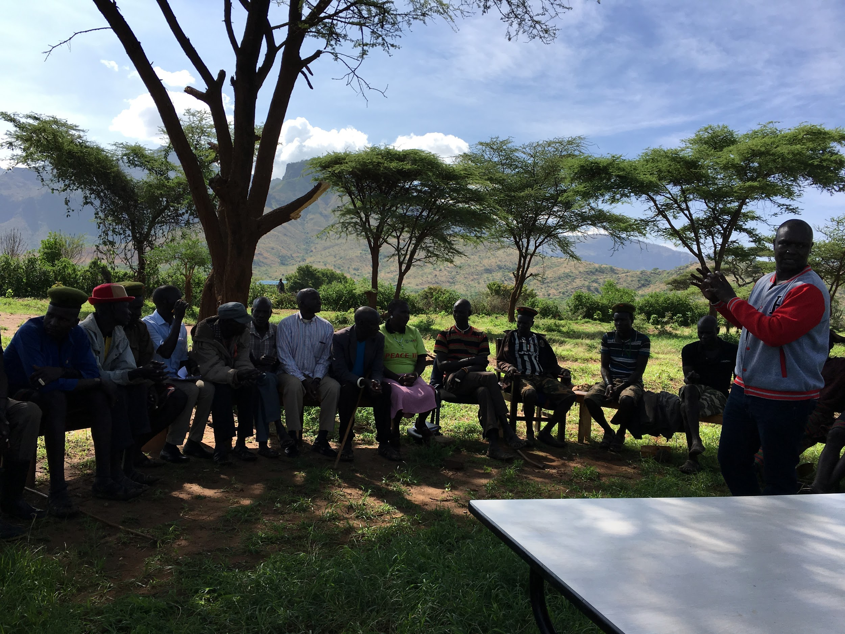
Future Risks & The Need for an Exit Strategy
Climate Vulnerability, Turkana
If the trend continues, more regions will face aid dependency crises.
Importance of developing local resilience and self-sufficiency.
Need for gradual transition strategies rather than abrupt aid cuts.

Slide 9
Alternative Models for Development
Blended Finance & Impact Investments: Attracting private capital for social impact.
Public-Private Partnerships (PPPs): Ensuring service delivery sustainability.
Strengthening Local Economies: Supporting Micro, Small, and Medium Enterprises (MSMEs).
Sovereign Wealth Funds & Infrastructure Investments: Examples from Botswana, Namibia, and South Africa.

Slide 10
The Way Forward – A Sustainable Future
Aid should be a tool, not a permanent solution.
Encourage regional economic integration and trade-based development.
Strengthen governance and local ownership of development initiatives.

Slide 11
Opportunities for Collaborative Governance and Decision Making
Supporting a virtuous cycle
Peace architecture as a consensus-based governance platform
Visioning what is possible
Providing pilot resources as demonstration for local governments as to what is possible
Continue to support host government ownership of the peace architecture
Support Collaborating, learning and adapting
Stress cross sector buy in and deep integration
Notes:
These “non-peace-and-conflict” issues include:
1) Income generation, livelihood enhancement, and alternative livelihoods
2) Market development and capacity building in finance and business
3) Water infrastructure development (pans, dams, small-scale irrigation)
4) Increased representation of women
5) Better access to health and education for children
6) Improved agricultural techniques
7) Better rangeland management
Peace committees and local communities are actively interested in expanding their sphere of activities to include livelihood enhancement (e.g., livestock trading), alternative livelihoods/income-generating activities, and capacity building for women and youth.
Communities in the project areas recognize that their accomplishments in peacebuilding are only sustainable with increased livelihood security and resilience.

